Slide 1
Towards achieving URLLC parameters using reinforcement learning in deciding task-offloading schemes for latency minimization in MEC Scenarios
Aswini Ghosh, Research Scholar, IIT Patna
Nelson Sharma, Research Scholar, IIT Patna

Slide 2
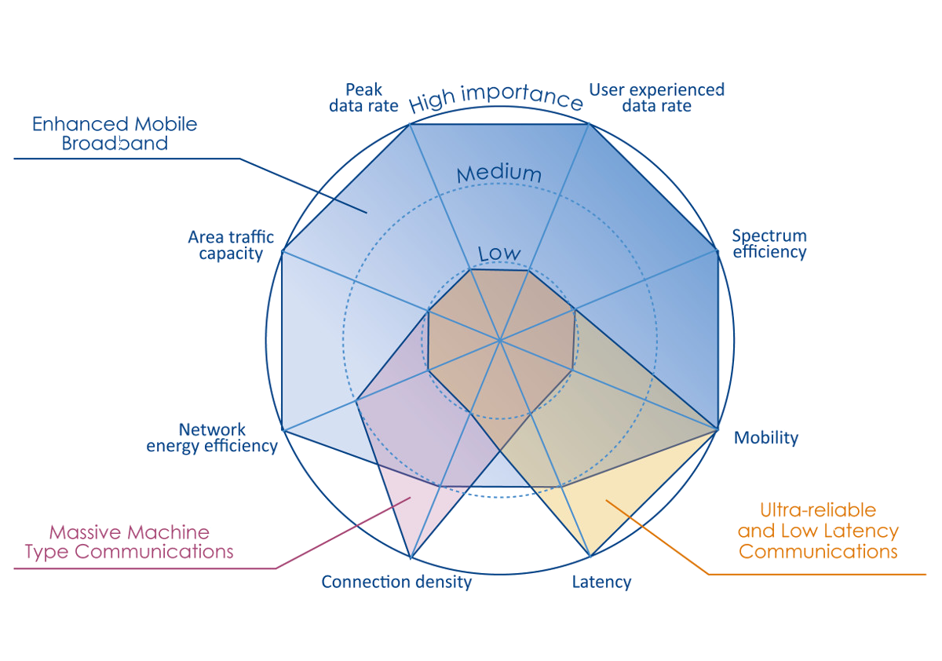
5G Application Areas

Slide 3
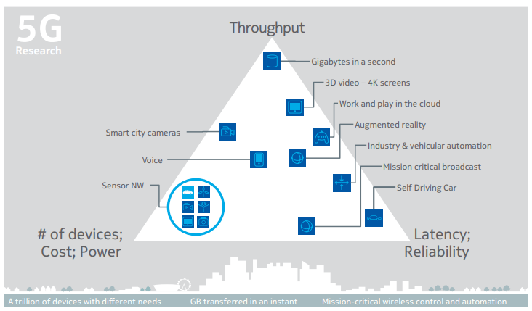

Slide 4
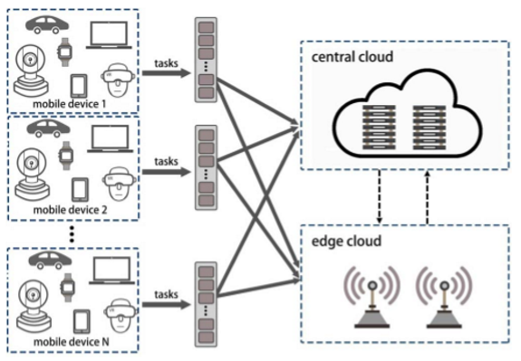
Multi-Access Edge Computing
MEC Provides cloud computing capabilities at the edge of radio access networks close to mobile users
Aims at providing users with high-bandwidth and low latency service experiences
MEC is widely recognized as a key technology to realize the next generation of Internet Services, such as the Tactile internet and the IoT, and to meet the QoS requirements for emerging services, such as cognitive assistance, augmented reality, and video edge analysis through proximity access.

Slide 5
MEC Environment Model
CLOUD
CLOUD
CLOUD
EDGE
EDGE
EDGE
EDGE
EDGE
EDGE
EDGE
EDGE
IoT Devices
IoT Devices
IoT Devices
IoT Devices
IoT Devices
IoT Devices
IoT Devices
IoT Devices
Multiple clouds and edge servers form an edge network

Slide 6
MEC Environment Model
CLOUD
CLOUD
CLOUD
EDGE
EDGE
EDGE
EDGE
EDGE
EDGE
EDGE
EDGE
Workflow
Workflow
Workflow
Workflow
Workflow
Workflow
Workflow
Workflow
Workflow
Workflow
Workflow
Workflow
Workflow
Workflow
Workflow
Workflow
Workflow
Workflow
Workflow
Workflow
Workflow
Workflow
Workflow
Workflow
IoT devices can connect to an Edge Server and can generate workflows containing a number of tasks such that each task is dependent on the previous task in the workflow.
In this scheme, Cloud Servers can be thought of as a special type of edge server which have no IoT devices connecting directly to them.

Slide 7
EDGE
EDGE
EDGE
Workflow
Workflow
Workflow
Workflow
EDGE
EDGE
EDGE
EDGE
EDGE
Workflow
Placement Algorithm
EDGE
EDGE
EDGE
Workflow
Workflow
Workflow
Edge Network
Workflows
Workflow
[ D ]
➔ Data Size (MB)
D(0)
D(1)
D(2)
. . .
D(T)
[ V ]
➔ Task Size (MC)
V(1)
V(2)
. . .
V(T)

Slide 8
Utility Model
Immediate Utility [F] → Weighted sum of delay and energy consumption in a State (Si) and taking Action (ai)
F(Si, ai) = Sum
Input_Tx (Si, ai) ← Transmission delay :: for moving data D(i-1) from location L(i-1) to location L(i)
Input_Ex (Si, ai) ← Energy consumption :: for processing data D(i-1) at location L(i)
Task_Cx (Si, ai) ← Computation delay :: for processing task V(i) at location L(i)
Task_Ex (Si, ai) ← Energy consumption :: for processing task V(i) at location L(i)
Output_Tx (Si, ai) ← Energy consumption :: for processing data D(i) at location L(i)
Output_Ex (Si, ai) ← Transmission delay :: for moving data D(i) from location L(i) to location L(0)
System Utility [U] → Weighted sum of delay and energy consumption for a given workflow. To calculate total utility, we need to sum up individual immediate utility values at each state.
U(Workflow, Policy) = SUM { F(Si, Li) } for i Є { 1, 2 … n }
NOTE: Weights are not shown!

Slide 9
Edge Network Constants
Consider the Edge Network to be made up of following servers
Edge Servers [E]
Cloud Servers [C]
Total Network Servers [N] = E + C
Each of the N network servers have the following attributes
Data Rate [DR] Bandwidth to other servers (MB/S)
Data Energy [DE] Energy Spent in Data Processing (J/MB)
Task Rate [VR] Clock Rate or Computation Power (MC/S)
Task Energy [VE] Energy Spent in Computation (J/MC)

Slide 10
Workflow Components and Constants
A workflow contains a fixed number of tasks
number of tasks per workflow [T]
Each task t [ t = 1, 2, … T ] is characterized by
Input Data size D(t-1)
Task size V(t)
Output Data size D(t)
The values of Task Size and Data Size in a workflow are subjected to limits defined as:
Range of initial Data Size D(0) [WF_D0_RANGE]
Range of other Data Size D(1) to D(t) [WF_DT_RANGE]
Range of all Task Sizes V(1) to V(t) [WF_VT_RANGE]
IoT Workflow
[ D ]
➔ Data Size (MB)
D(0)
D(1)
D(2)
. . .
D(T)
[ V ]
➔ Task Size (MC)
V(1)
V(2)
. . .
V(T)

Slide 11
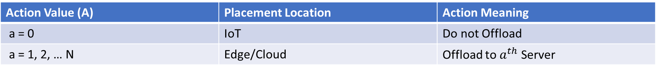
Task Offloading Decision and Actions
An ‘agent’ processes one workflow at a time and decides an offloading ‘policy’ for placing all the tasks of that workflow at appropriate devices.
An actions or placement location is defined as:
Action, a Є { 0, 1, 2 … N } where N = E + C
Hence, Total number of Actions [A] = N + 1
Action Value (A) | Placement Location | Action Meaning
a = 0 | IoT | Do not Offload
a = 1, 2, … N | Edge/Cloud | Offload to $a^{th}$ Server
Actions
0
1
. . . edge . . .
E
E + 1
. . . cloud . . .
E + C

Slide 12
The End

Slide 14
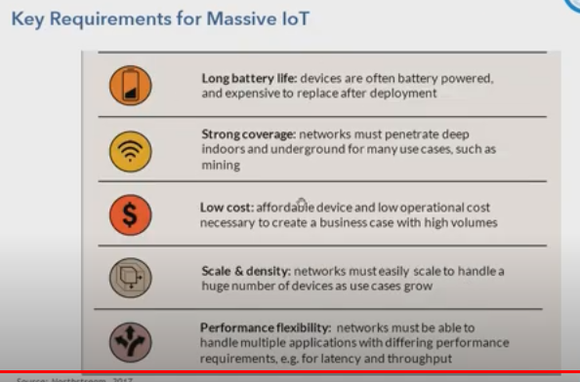

Slide 15
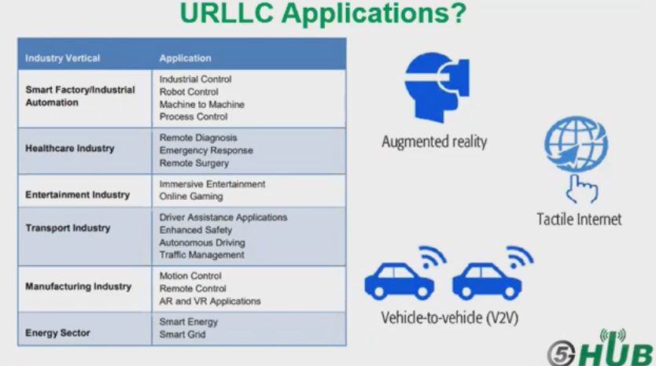

Slide 16
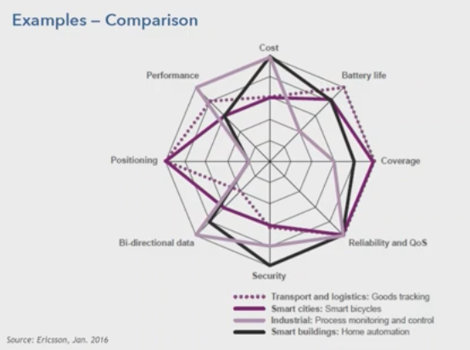

Slide 17
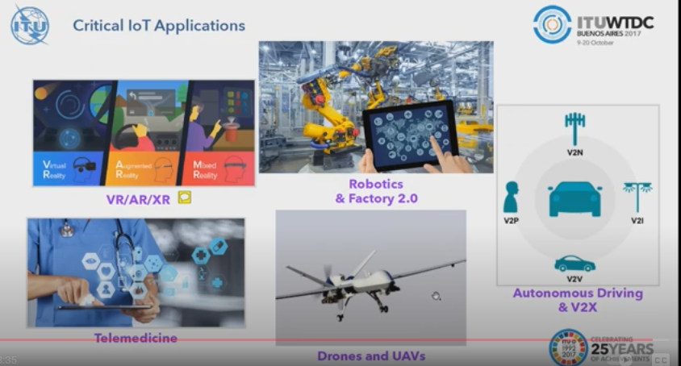

Slide 18
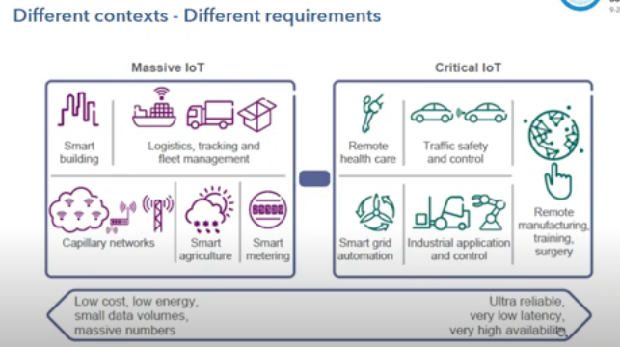

Slide 19
